Slide 1
Problem Solving
Nayon Debnath Dipu
Assistant General Manager @ Bit Mascot

Slide 2
Design Thinking
What is Design Thinking and Why Is It So Popular?

Slide 3

Global Practice
Some of the world’s leading brands, such as Apple, Google, Samsung, and GE, have rapidly adopted the Design Thinking approach, and Design Thinking is being taught at leading universities around the world, including d.school, Stanford, Harvard, and MIT.

Slide 4
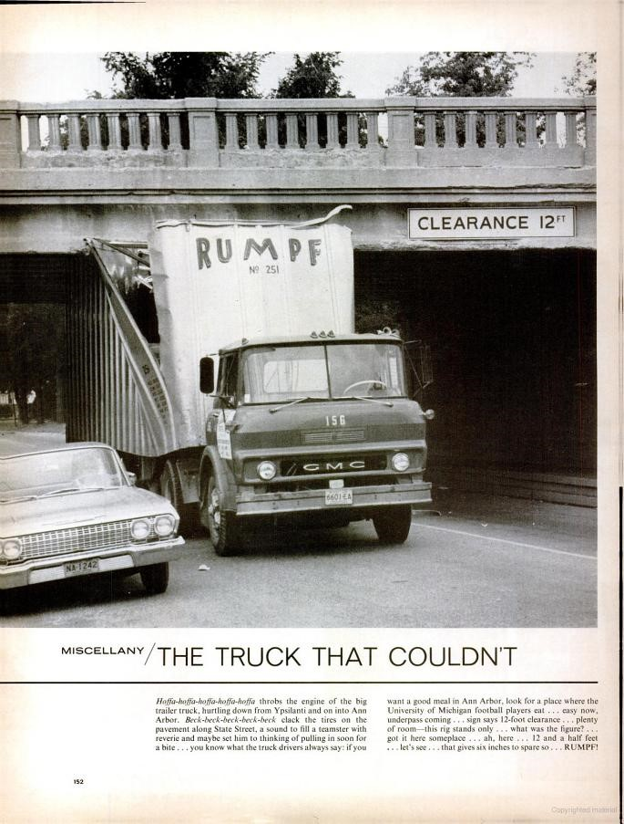
An Example of Problem solving
Thinking outside of the box can provide an innovative solution to a sticky problem. However, thinking outside of the box can be a real challenge as we naturally develop patterns of thinking that are modeled on the repetitive activities and commonly accessed knowledge we surround ourselves with.

Slide 5

Design Thinking or 'Outside the Box' Thinking
Design Thinking is often referred to as ‘outside the box’ thinking, as designers are attempting to develop new ways of thinking that do not abide by the dominant or more common problem-solving methods.

Slide 6
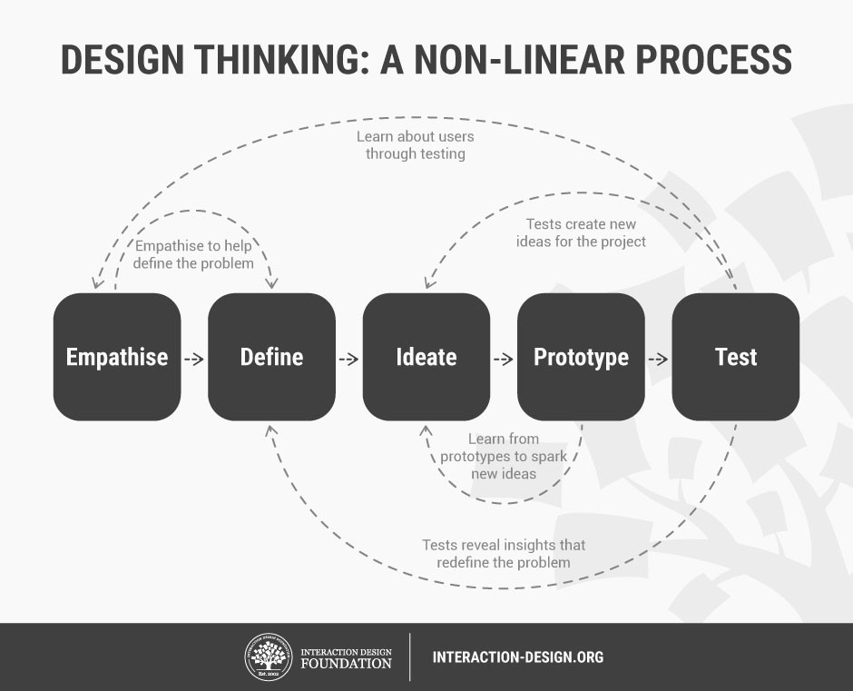
Process
Empathise - with your users
Define – your users’ needs, their problem, and your insights
Ideate – by challenging assumptions and creating ideas for innovative solutions
Prototype – to start creating solutions
Test – solutions

Slide 7
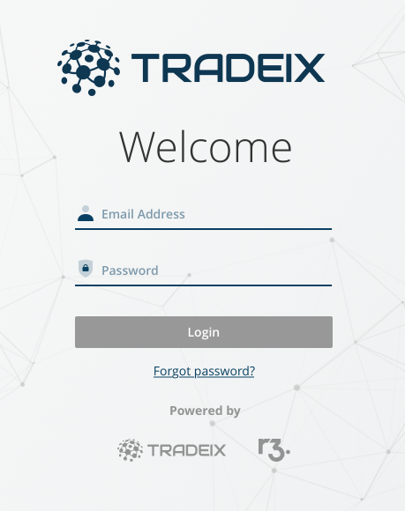
Let’s discuss with a problem
Reset Password flow
As an user, I should have the ability to ‘Reset Password’. It can be if I forget my password or if my old password is expired or if I get locked.

Slide 8
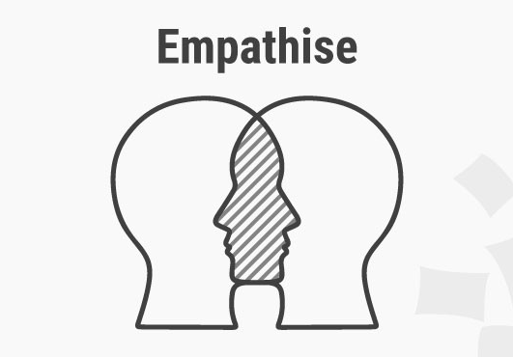
Empathise
The first stage of the Design Thinking process is to gain an empathic understanding of the problem you are trying to solve.
Source: Interaction Design Foundation
User can forget his password and then he will have to reset his password to login into the system. And if the user enters the wrong password 3 times, the system will lock the user automatically. Then the user will have to request to the system admin to unlock him. Also, the user will have to reset his password if the password is expired. A request to system admin is required then.

Slide 9
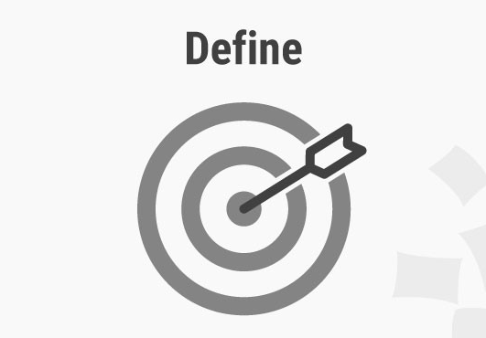
Define
During the Define stage, you put together the information you have created and gathered during the Empathise stage.
Source: Interaction Design Foundation
Ability to request ‘Reset Password’ if user forgets his password
Ability to request ‘Reset Password’ if user finds him locked in the system (Entering wrong password 3 times)
Ability to send notification to user with reset password link (System Admin will perform this action)

Slide 10
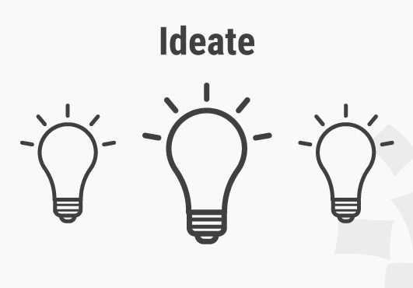
Ideate
During the third stage of the Design Thinking process, designers are ready to start generating ideas. Sketch, Brainwalk, Mindmap, Storyboard, SCAMPER are the few of Ideation techniques.
Source: Interaction Design Foundation
https://www.interaction-design.org/literature/article/introduction-to-the-essential-ideation-techniques-which-are-the-heart-of-design-thinking
We can keep a ‘Forgot Password’ link in the login page. That will take the user to get the ‘Reset Password’ link in his email.
We can show the ‘Request Reset Password’ option to send a request to the ‘System Admin’ to send a ‘Reset Password’ link to the user.
Admin can have a ‘Unlock’ button in user grid to unlock and that action will send a notification with ‘Reset Password’ link to user via email.

Slide 11
SCAMPER
Substitute: Look at your current products or processes, and ask yourself. Could you substitute any parts for more affordable or effective alternatives?
Combine: Have you tried creating something new by mixing two existing parts of your business?
Adapt: How could you transform your product to fill a gap in the market?
Modify: Why not try changing the look feel or shape of your product?
Put to another use: Could your product be useful elsewhere? Or, could you adapt to reach a wider target audience?
Eliminate: Is your product as streamlined as possible? How could you simplify it?
Reverse: What would happen if you did the exact opposite to what you are doing now?

Slide 12
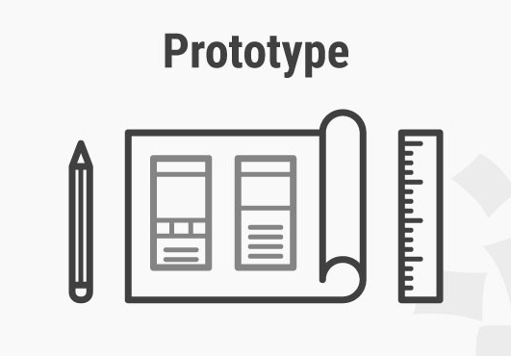
Prototype
The design team will now produce a number of inexpensive, scaled down versions of the product or specific features found within the product, so they can investigate the problem solutions generated in the previous stage.
Source: Interaction Design Foundation
Put a ‘Forgot Password’ link into the login page. Design the ‘Email Notification’ for the user. Design User list in admin panel with the option to send a ‘Reset Password’ link to the user. Design other relevant screens and include them considering all happy paths and unhappy paths (if ‘Reset Password’ link expired) into the flow.

Slide 13
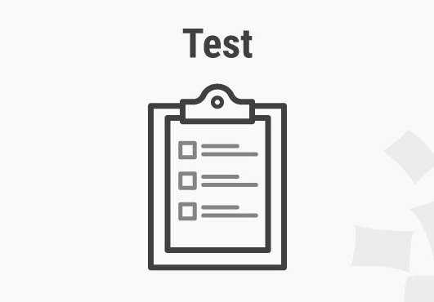
Test
Designers or evaluators rigorously test the complete product using the best solutions identified during the prototyping phase.
Source: Interaction Design Foundation
Best way to test a prototype is to have user feedback. Prototypes to be tested also by your Design Lead, Architects or other stakeholders. This also can be evaluated in refinement session. As well as new issues and challenges come, they should be included in the flow and to be tested again before handing it over to developers.

Slide 14
Let’s talk about
‘Lean UX’

Slide 15
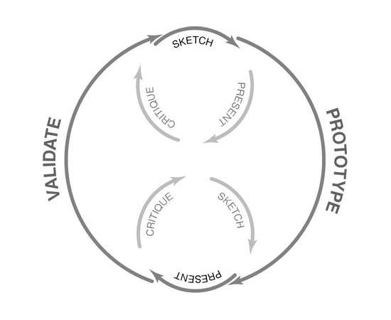
A Simple Introduction to Lean UX
Lean UX is an incredibly useful technique when working on projects where the Agile development method is used. Traditional UX techniques often don’t work when development is conducted in rapid bursts – there’s not enough time to deliver UX in the same way.

Slide 16
Lean UX
Lean UX – What is It?
Lean UX is slightly different. You aren’t focused on detailed deliverables. You are looking to produce changes that improve the product in the here and now – essentially to mould the outcome for the better.
Typical questions might include:
Who are our users?
What is the product used for?
When is it used?
What situations is it used in?
What will be the most important functionality?
What’s the biggest risk to product delivery?

Slide 17
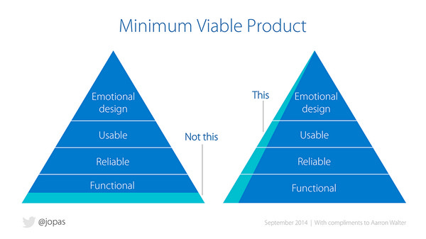
The MVP and Lean UX
The Minimum Viable Product (MVP) is a core concept in Lean UX. The idea is to build the most basic version of the concept as possible, test it and if there are no valuable results to abandon it.
Source: Interaction Design Foundation

Slide 18

Thank You

Slide 19
UX for Enterprise
Monirul Islam
Senior UI/UX Designer @ Bit Mascot

Slide 20
Enterprise software, also known as enterprise application software, is purpose-designed computer software used to satisfy the needs of an organization rather than individual users.
Wiki
Notes:
Its for employees, not for consumers.

Slide 21
Enterprise UX Design vs. Startup UX Design
When it comes to enterprise UX design, teams are often responsible for building or improving upon products as efficiently as possible. The pressure to meet deadlines can cause some teams to neglect key elements of a strong user experience.
The same can’t always be said for user experience designers at new startups. Since the organization doesn’t have any existing customers yet, there’s simply less pressure to deliver the product. The goal at the start is merely to build the strongest app possible.

Slide 22

Who is our user?
Pharma Researcher
Call Center Representative
Bank Teller
Accountant
Lawer
IT Admin
HR Representative
Air Traffic Controller

Slide 23
Where do we start?
Listen
Understand
Act

Slide 24

Where do we start?
Follow the process
Understand the difference between Enterprise and Startup
Focus on user’s goals
See outside your current project
Make it simple

Slide 25
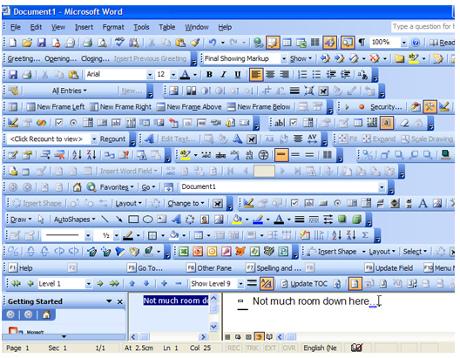
Simplicity
Simplicity is often referred to as one of the fundamental principles of UX design. More and more features keep getting added in to a product without them being properly thought out. Biggest challenge is to keep think sorted and simple!

Slide 26

Understand what to put first
What are the challenges
Analyse the task list
Where to focus first

Slide 27

Dealing with feedbacks
The Knocker
“This is wrong. We don’t do that here!”

Slide 28

Dealing with feedbacks
The Torpedo
“What the hell!. That’s not what I asked for!”

Slide 29
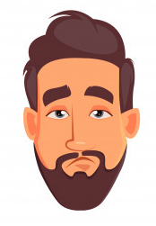
Dealing with feedbacks
The Hiro Designer
“This is my design. If you don’t like it, go with somebody else. ”

Slide 30
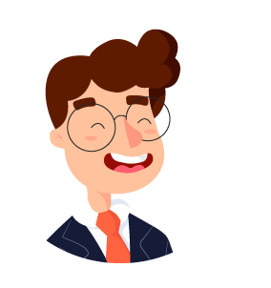
Dealing with feedbacks
The Hiro Manager
“Ok I am ganna think about the problem and come up with a solution that will solve everything. ”

Slide 31
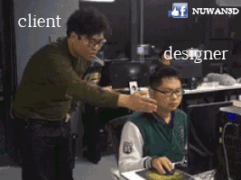

Slide 32

What we can do!
Engage them in design solution
Understand there is always room for opportunity even the solution comes from you!
Use reference examples in refinements
Describe your design

Slide 33







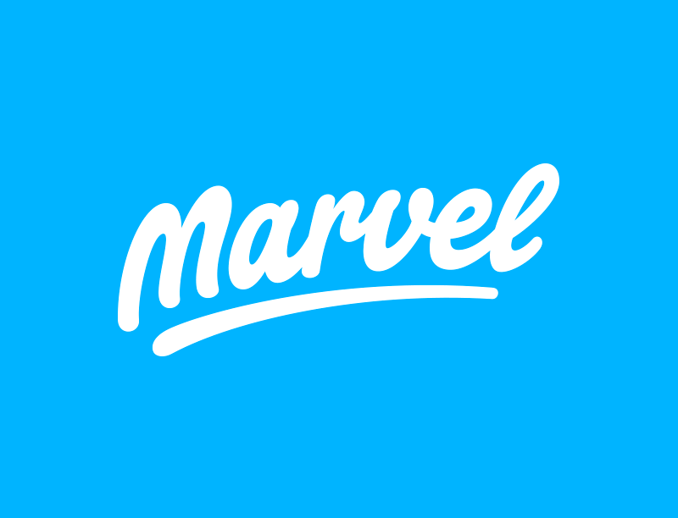

Design tools

Slide 34
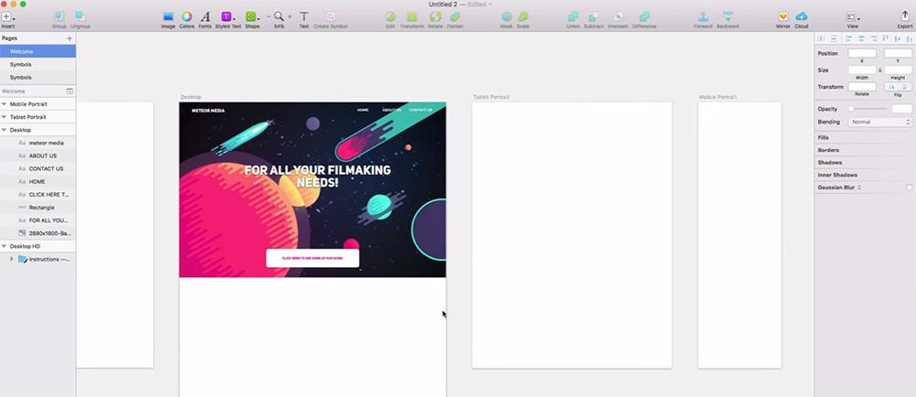
Design tools
September 2010

Slide 35
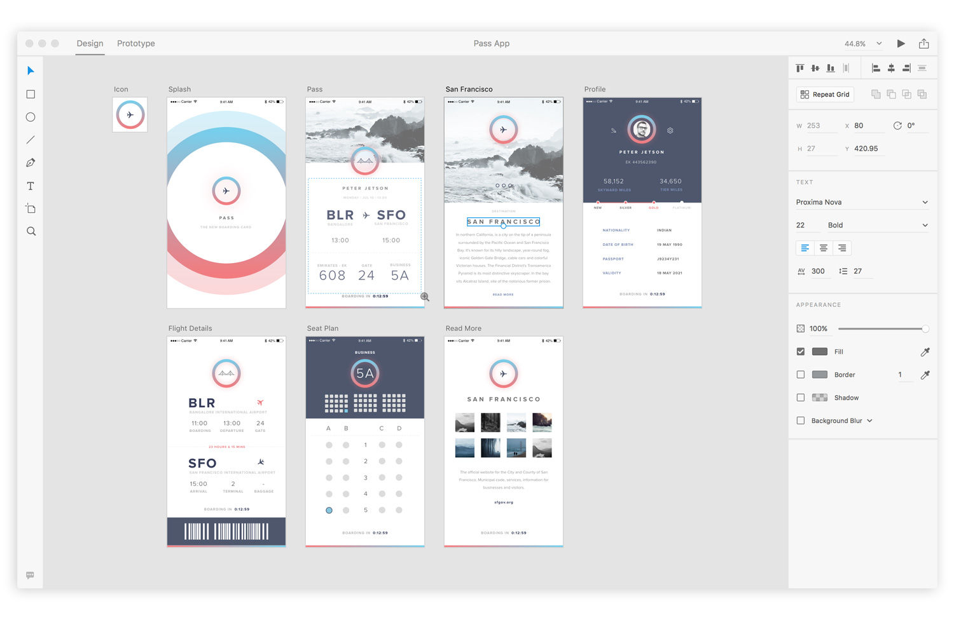
Design tools
March 14, 2016

Slide 36
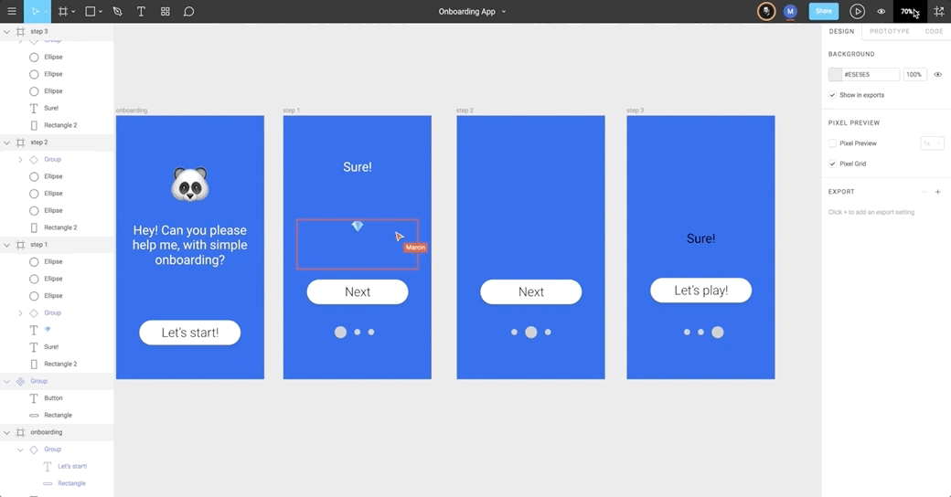
Design tools
Founded Date Oct 1, 2012

Slide 37
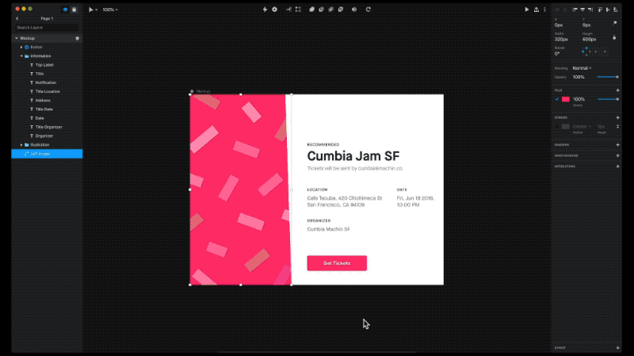
Design tools

Slide 38
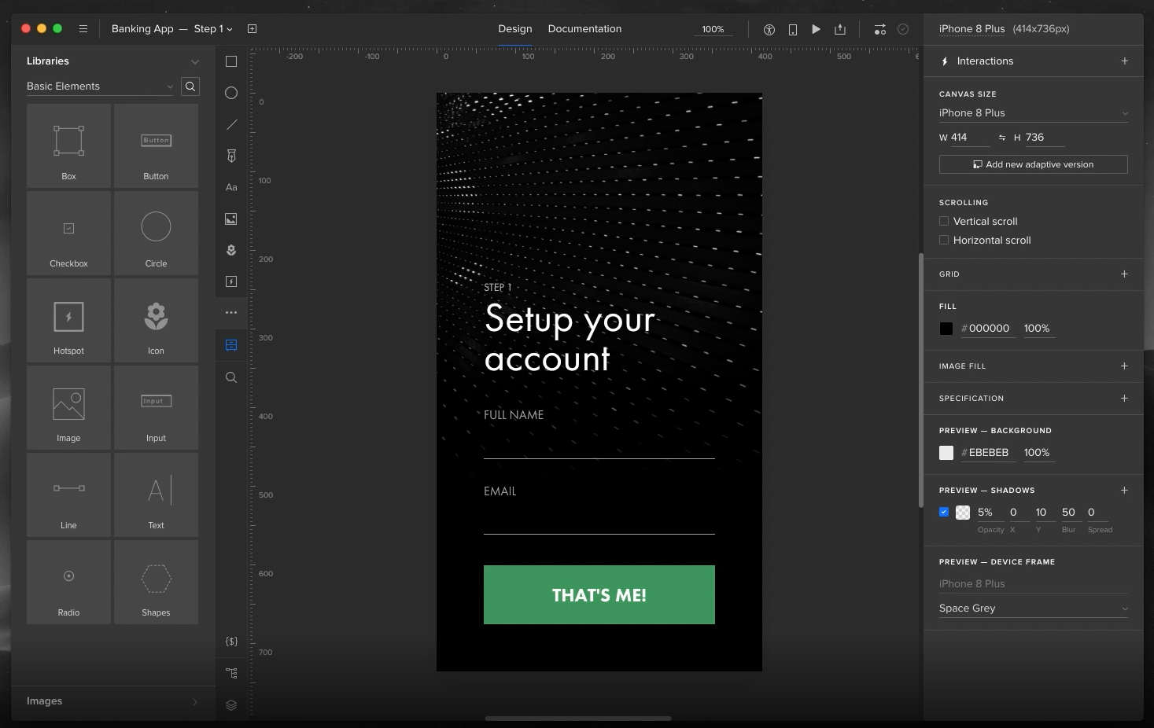
Design tools

Slide 39
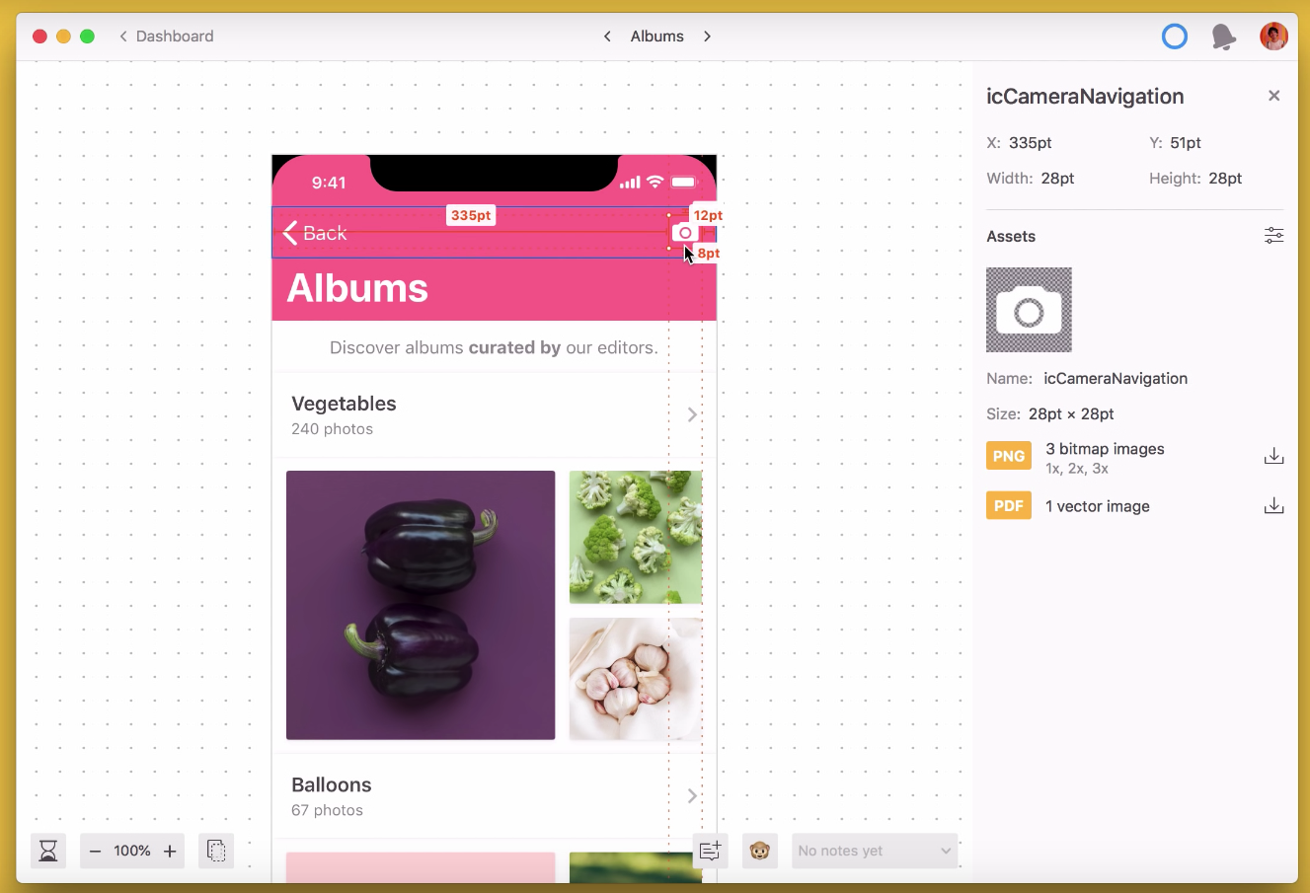
Design tools
Founded Date 2014

Slide 40
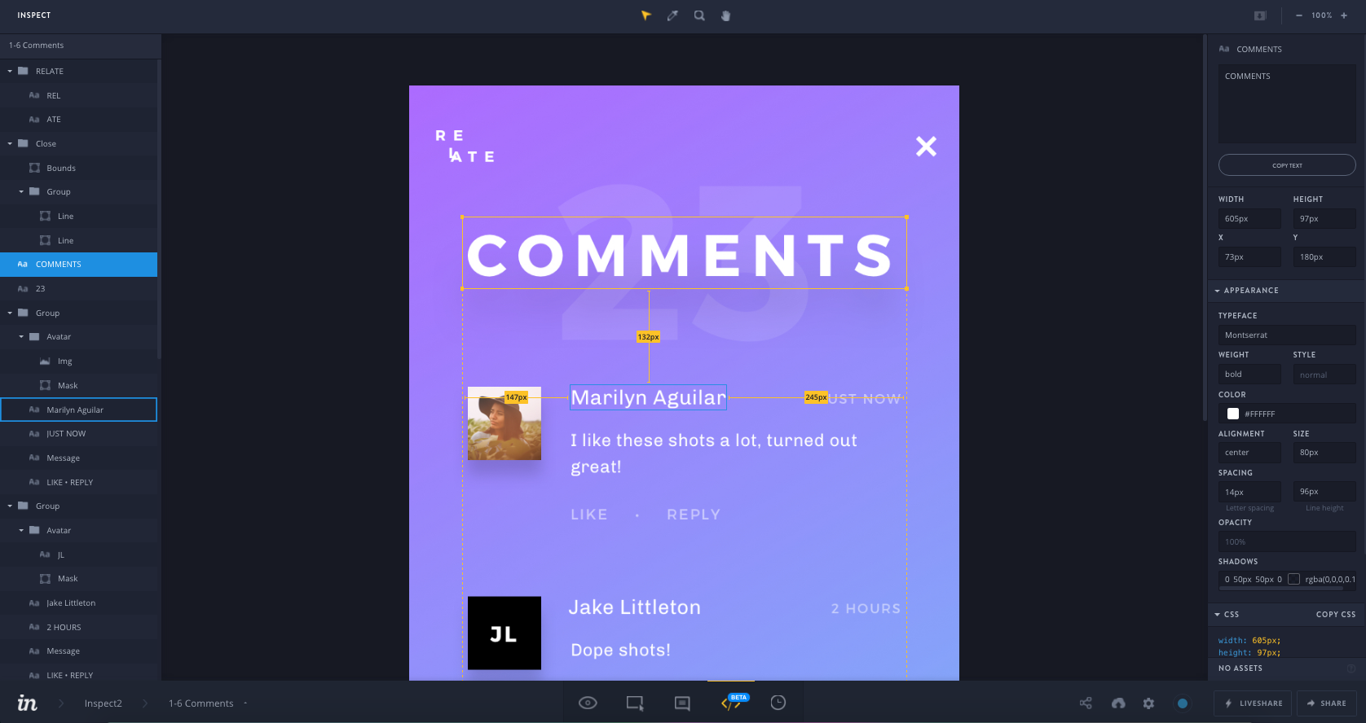
Design tools
Founded Date 2011

Slide 41
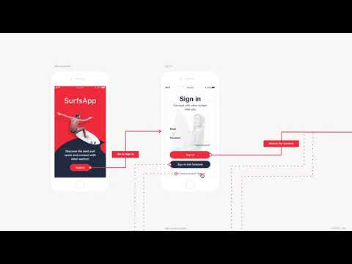
Design tools

Slide 42
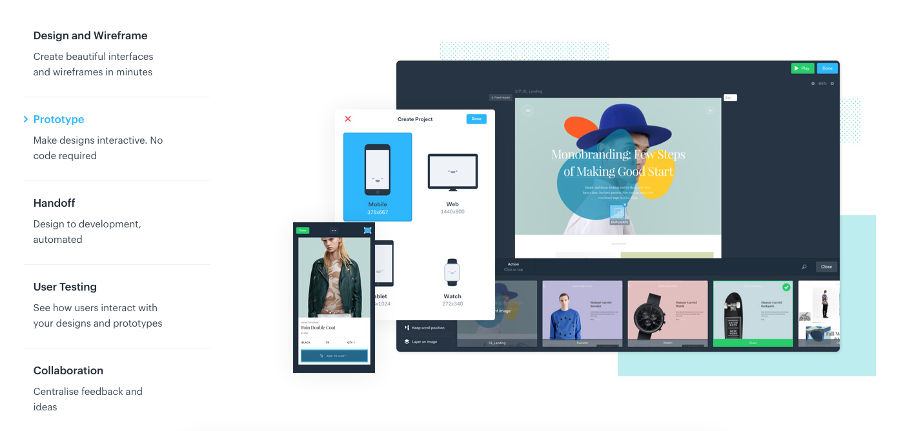
Design tools
Founded Date 2013

Slide 43


